Slide 1
Gas laws
Unit 2

Slide 2
Learning goals
• State the relationship between the volume of a gas, number of moles and molar volume at standard temperature and pressure (STP).
• Apply the kinetic theory of gases to explain the relationships between pressure, temperature, and volume of a gas.
• Identify that the kinetic theory of gases applies to ideal gases.
• Apply the ideal gas equation to calculate the mass of chemicals and/or the volume of a gas (STP) involved in a chemical reaction. (Formula: PV = nRT)
• Analyse data to determine the relationships between pressure, temperature, and volume of a gas.

Slide 3
Vocab List
Kinetic
Moles
Ideal gas
Avogadro
Volume
STP
SLC
Molar Volume
Pressure

Slide 4
Warm Up
1. Identify and describe 3 types of intramolecular forces.
Covalent bonds: ______________________________________
_______________
_______________
2. Identify and describe 3 types of intermolecular forces.
Van der Waals forces: ______________________________
_______________
_______________

Slide 5
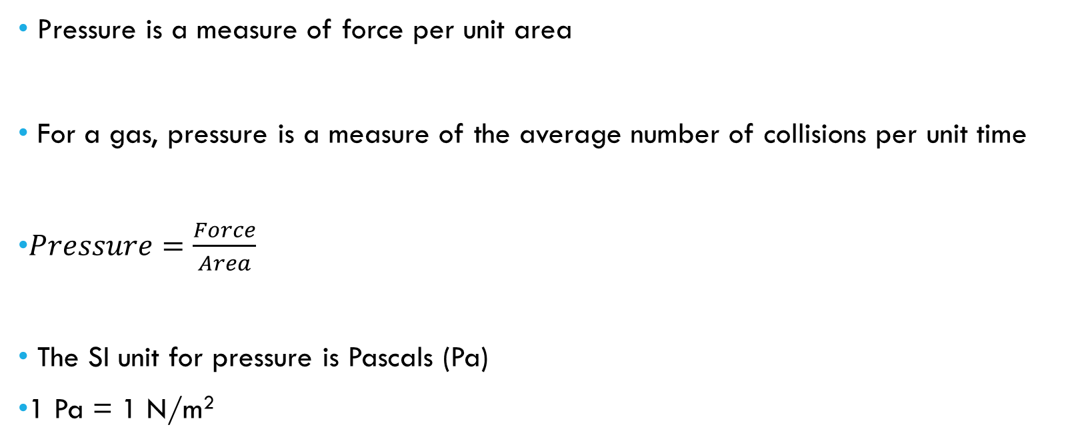
Pressure
Pressure is a measure of force per unit area
For a gas, pressure is a measure of the average number of collisions per unit time
$Pressure=\frac{Force}{Area}$
The SI unit for pressure is Pascals (Pa)
1 Pa = 1 N/m²
Don’t remember this, just understand that this is how pressure is measured
Notes:
Unit area is a way of saying “per surface area” Unit time is a way of saying “per time” P = pressure
F = force
A = area

Slide 6
Other units for pressure
Kilopascals
1 kPa = 1000 Pa
Atmospheres (atm)
1 atm = 101.3 kPa
Millimetres of Mercury (mmHg)
1 mmHg = 133.3 Pa
1 kPa = 7.5 mmHg

Slide 7
Ideal gases
Used as a simplified model to predict the behaviour of gases.
Behaviour of real gases is complicated.
The ideal gas assumptions are suitable for modelling gases at higher temperatures and lower pressures.
Model starts to fail at low temperatures and at high pressures.

Slide 8
Ideal gases - assumptions
1) All gas molecules display the same behaviour. No differences arise from different molecules / chemical nature (i.e. O₂ , H₂, Cl₂, and CO₂ gas would all display the same behaviour).
2) Gas molecules do not interact with each other – intermolecular forces are negligible.
3) The volume of gas particles is negligible compared to the volume taken up by the gas.

Slide 9
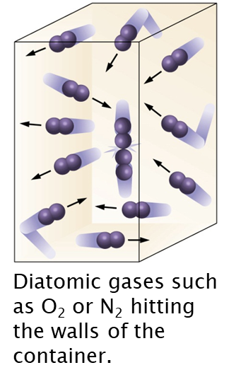
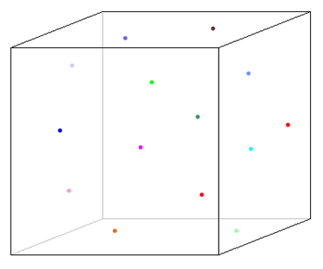
Kinetic theory of gases
1. A gas consists of small particles (atoms or molecules) that move randomly with rapid velocities. Gas molecules moving in all directions at high speeds cause a gas to fill the entire volume of a container.
2. Intermolecular forces between gas particles are negligible. Gas particles move far apart and will expand to fill a container of any size and shape.
3. The actual volume occupied by gas molecules is very small. Most of the volume of a gas is empty space, which allows gases to be compressed.

Slide 10
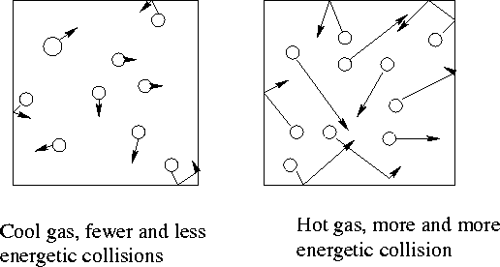
Kinetic theory of gases
4. The average kinetic energy of gas molecules is directly proportional to the temperature (in Kelvin). Gas particles move faster as the temperature increases, hitting the walls of the container with more force and producing higher pressures.
5. Gas particles move in straight paths until colliding with other gas particles or with the walls of the container to bounce off elastically in other directions. An increase in either the frequency or force of collisions against the walls of the container causes an increase in the gas pressure.
Notes:
Elastically = without the loss of any momentum (technically impossible), i.e. it will rebound with the exact same speed it had going into the collision.

Slide 11
Ideal Gases – conditions (memorise)
Standard Temperature and Pressure (STP)
STP = 273 K (0ºC) and 100 kPa, 22.4 L/mol
Standard Laboratory Conditions (SLC)
SLC = 298 K and 100 kPa, 24.8 L/mol
Room Temperature and Pressure (RTP)
RTP = 298 K and 1 atm, 24.0 L/mol

Slide 12
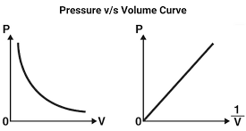
Boyle’s law
Inverse relationship between volume and pressure.
As volume increases, pressure decreases.
*When temperature and moles are constant.
V₁P₁ = V₂P₂

Slide 13
Boyle’s law practice questions
1) If a gas at 25.0 °C occupies 3.60 liters at a pressure of 1.00 atm, what will be its volume at a pressure of 2.50 atm?
2) A gas occupies 12.3 liters at a pressure of 40.0 mmHg. What is the volume when the pressure is increased to 60.0 mmHg?
3) A gas occupies 1.56 L at 1.00 atm. What will be the volume of this gas if the pressure is increased to 3.00 atm?
4) Two bulbs of different volumes are separated by a valve. The valve between the 2.00 L bulb, in which the gas pressure is 1.00 atm, and the 3.00 L bulb, in which the gas pressure is 1.50 atm, is opened. What is the final pressure in the two bulbs, the temperature being constant and the same in both bulbs?

Slide 14
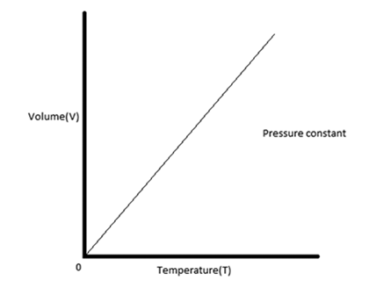
Charles’ Law
Proportional relationship between temperature and volume.
As temperature increases, volume also increases.
*When pressure and moles are constant.
V₁/T₁ = V₂/T₂

Slide 15
Charles’ law practice questions
1) Calculate the decrease in temperature (in Celsius) when 2.00 L at 21.0 °C is compressed to 1.00 L.
2) A gas occupies 900.0 mL at a temperature of 27.0 °C. Calculate the volume if the temperature is increased to 132.0 °C.
3) At 210.0 °C, a gas has a volume of 8.00 L. Calculate the volume of this gas at -23.0 °C.
4) An open "empty" 2 L plastic pop container, which has an actual inside volume of 2.05 L, is removed from a refrigerator at 5 °C and allowed to warm up to 21 °C. Calculate the volume of air that will leave the container as it warms to 21 °C?

Slide 16
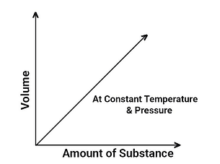
Avogadro’s law
Proportional relationship between moles and volume.
As number of moles increase, volume also increases.
*When pressure and temperature are constant.
V₁/n₁ = V₂/n₂

Slide 17
Avogadro’s law practice questions
1) 5.00 L of a gas is known to contain 0.965 mol. If the amount of gas is increased to 1.80 mol, calculate the new volume (at constant temperature and pressure).
2) A cylinder with a movable piston contains 2.00 g of helium (He) at 298 K. More helium was added to the cylinder and the volume was adjusted so that the gas pressure remained the same. Calculate the mass of helium that was added to the cylinder if the volume was changed from 2.00 L to 2.70 L at constant temperature. Give your answer in grams.
3) At a certain temperature and pressure, one mole of diatomic H₂ gas occupies a volume of 20 L. What would be the volume of one mole of He atoms under those same conditions?

Slide 18
Ideal gas law
PV = nRT
Where:
P = Pressure (kPa)
V = Volume (L)
n = number of moles (mol)
R = Ideal gas constant 8.314 J/K/mol
T = Temperature (K)

Slide 19
Ideal gas law – alternative ‘R’ constant
* Important point is to make sure that your units are consistent.
You may also see the ideal gas constant R = 0.082 L atm / K / mol
If you use this gas constant, you need:
P = Pressure (atm)
V = Volume (L)
n = moles (mol)
R = 0.082 L.atm/K/mol
T = temperature (K)

Slide 20
Practice questions
1) Derive Boyle’s Law from the Ideal Gas equation.
2) Derive Charles’ Law from the Ideal Gas equation.
3) Calculate the number of moles of CO₂(g) in a 5.6 L sample of CO₂ measured at STP.
3) At 150ºC and 100 kPa, 1.00 L of a compound has a mass of 2.506 g. Calculate its molar mass.
4) Calculate the mass of Cl₂ (g) that can be stored in a 10.0 L container at 1000 kPa and 30ºC.
5) A balloon containing 2L of gas at STP is heated to SLC. Determine the new volume of the balloon.

